Slide 2

Basho Technologies
Coming Together

Slide 4

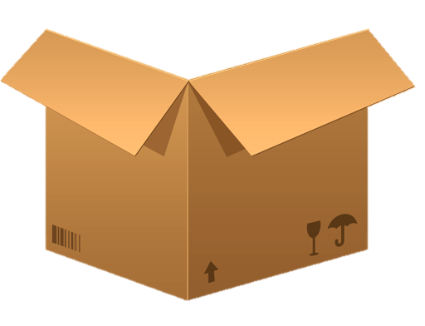
Notes:
Bare minimal data store

Slide 5


Notes:
Used to contain data
Designed, contains 2
Contains:
Samurai
Santa Clauses

Slide 6



Notes:
At some point you have too much data to fit on one server
More objects, different objects?
Too many objects for one box
What do you do?

Slide 7
Notes:
You add more machines to store things
This creates a problem, where do things go, and how do you get them?

Slide 8





???
cowboys
hall monitors
samurai
dr. who’s
Notes:
A typical scheme looks like this
All things of this type go here
- map, based on type
But what are the problems?
- only 1 Dr. Who
- No body wants to be a hall monitor
- everyone wants to be a cowboy
- No Samurai’s left, Tom Cruize was the last one
Imbalance
Where do you put new things?
Resource misallocation
Eventually you’ll have to rebalance

Slide 9
Notes:
What if there was some other way of dividing the data evenly
A different attribute maybe, instead of weather they’re a cowboy or santa clause

Slide 10

(
)
hash_me
= 0
Claus, Santa
0
1
2
3
Notes:
So what do we do?
Instead of using some classification to determine where to put the data
We take the key, and perform a hash function on that key, to get a 180 bit integer
we use a consistent hash function on the key.
Always converts the key to the same number
Divide up the possible number ranges

Slide 11
Consistent Hashing
Notes:
We call this consistent hashing
Our version of sharding
What this gives us is this: (next slide)

Slide 12








(
)
hash_me
= 0
Claus, Santa
0
1
2
3
Notes:
Data is now evenly distributed
resources are evenly utilized
The guy with the map knows where every object should go
Think about how clever that is
- all you need is the function, which doesn’t change

Slide 13
0 to …
… to …
… to …
… to 2¹⁶⁰
Notes:
We use the SHA-1 hash function, which, given a bucket/key, gives us a number between 0 and 2^160
Give each one of these partitions a range
So we’re able to evenly distribute data and evenly utilize resources
But what if we need to add a physical node?
We’d have to change the ranges, and find all the objects that need to move, so we can re -shuffle

Slide 14
Notes:
So what do we need?
We want an object to always live in the same partition, so we don’t have to rehash the object or sift through all the objects
But we also want physical nodes to be able to change what portion of the ring it’s responsible for?
So what do we do?

Slide 15

2¹⁶⁰
0
2¹⁶⁰/2
Notes:
We divide up the 160bit number into a large number of partitions, and then put multiple partitions on physical nodes, depending on how many physical nodes are in the cluster
This is a much smaller number than normal in order to make the boxes visible
- you’ll see upwards of 512 in the wild
Multiple partitions can live on a physical node
When nodes join or leave a cluster, these partitions can be passed around
- instead of sifting through objects
So on top of the consistent hashing function, we also now need a mapping of which partitions live on which physical node

Slide 16
The Ring
Notes:
This is what we call “The Ring”
You’ll see this
- app.config – ring_creating_size
- docs – some properties/state are passed in the ring
The the main purpose of the ring is defining the partitions of the 160bit number (next slide)

Slide 17
2¹⁶⁰
0
2¹⁶⁰/2
Notes:
And the mapping of those partitions to the physical nodes, as depicted by this map guy (next slide)

Slide 18
2¹⁶⁰
0
2¹⁶⁰/2
Notes:
Here we have every other partition handled by the next physical node, the reasoning for this will be more clear when we talk about redundancy

Slide 19
Notes:
Here we have the partitions on the nodes who owns them

Slide 20

node
vnode
(vee-node)
Notes:
And here we have the vnodes, which each manage one partition.
You’ll here vnodes and partitions used interchangeably, but for the most part
Vnodes are the process or service which manages a partitions, so there’s a 1:1 mapping

Slide 21
where to?
Notes:
So when a new object gets put into the cluster, it can hit any of these nodes

Slide 22
here
over there
this way to your partition, sir.
over there
over there
Notes:
If it hits one of the other nodes,
it’ll hash the key,
which will tell them which partition to put Santa,
and then they’ll look at their map to figure out
which physical node owns that partition

Slide 23
Notes:
So what happens when we need to add a node to the cluster?
Obviously certain partitions need to be owned by the new physical node, but the whole 160bit space has been claimed already, it’ll have to take partitions from the other nodes.
We call this (next slide)

Slide 24
Handoff
Notes:
Handoff is what we call moving partitions around, which can happen when we change the cluster size

Slide 25
Notes:
So here we have 4 nodes
Maybe they can’t handle the load
Maybe someone read the docs and realized you shouldn’t run a smaller cluster than 5 in production

Slide 26
i’m here to help!
Notes:
And a new one joins the scene
It gets joined to the cluster, and a new map is passed around which includes the 5th node

Slide 27
Notes:
Once the nodes realize they have a partition that’s owned by the 5th node, they begin handing off their partitions to him

Slide 28
Notes:
Because this was an intentional cluster change, the ownership of these partitions change

Slide 29
Ownership

Slide 30
Notes:
But this isn’t the only reason that handoff occurs

Slide 31
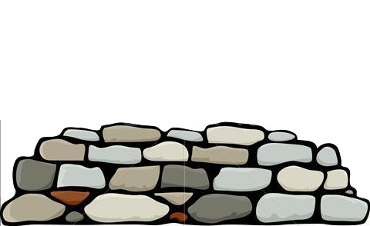
here
right this
way sir
Notes:
What if a node is down
- crash, network issues, etc

Slide 32
here
where to?
right this
way sir
Notes:
--

Slide 33
here
right this
way sir
where’d
he go?
over th…
Notes:
--

Slide 34
here
right this
way sir
hang here
for a bit.
Notes:
--

Slide 35
i’m back!
gah, finally!
Notes:
60 sec counter

Slide 36
sonny!
mama!
Notes:
--

Slide 37
Hinted

Slide 39
2¹⁶⁰
0
2¹⁶⁰/2
Notes:
--

Slide 40
2¹⁶⁰
0
2¹⁶⁰/2
Notes:
--

Slide 41
Replication

Slide 42
Notes:
--

Slide 43
N - Value (n_val = 3)

Slide 45
Consistent Hashing
Notes:
Removes the guess work from sharding
Evenly distributes data

Slide 46
The Ring
Notes:
Partitions from 0 to 2¹⁶⁰
1 to 1, vnodes to partitions
Divided as evenly as possible amongst the nodes

Slide 47
Handoff
Notes:
Ownership – happens as intentional administration
Hinted – happens in failure modes

Slide 48
Replication

